Slide 1
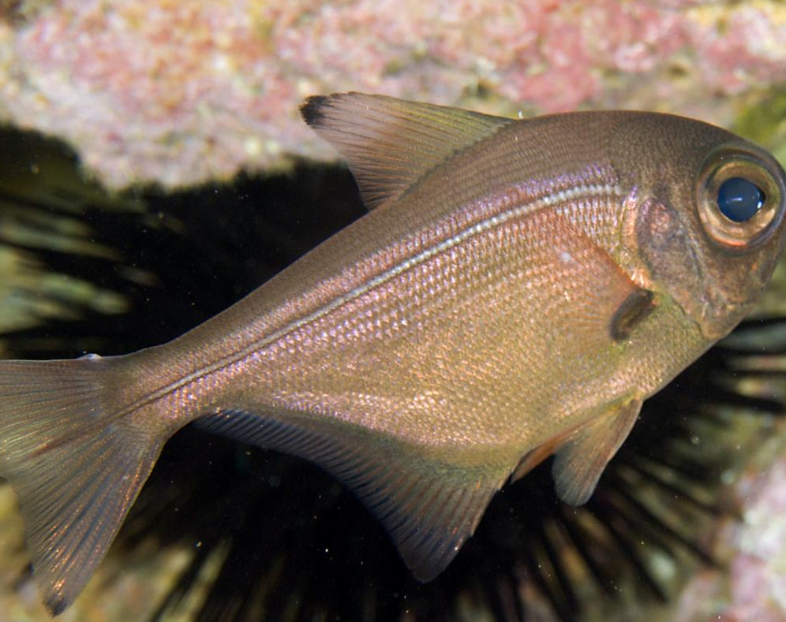
Intelligent Detection of New Zealand Bigeye Vocalisation Signals
Isabella Finan-Jenkin | Vishnu Koilkandadai
Pempheris Adspersa, Adult, Poor Knights Is, New Zealand, Photo: Andrew Green

Slide 2
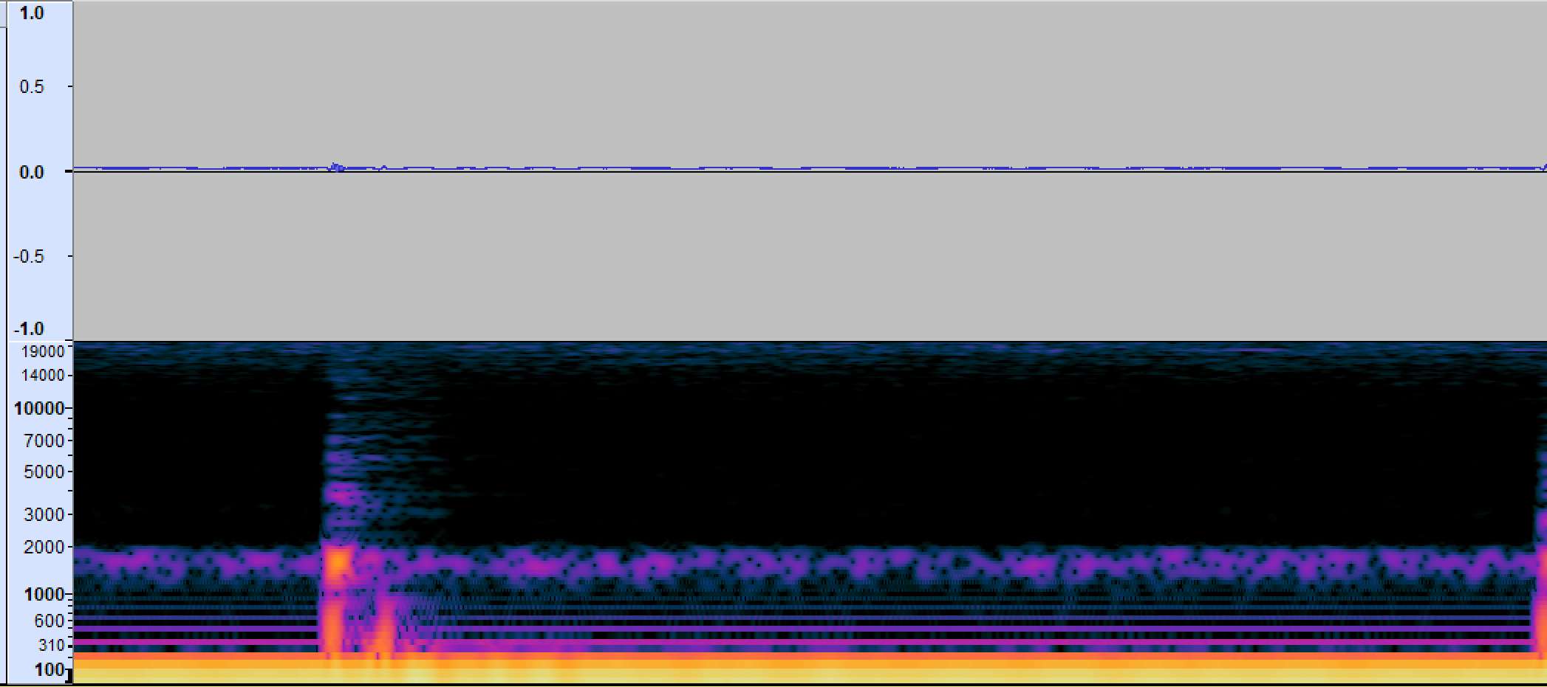
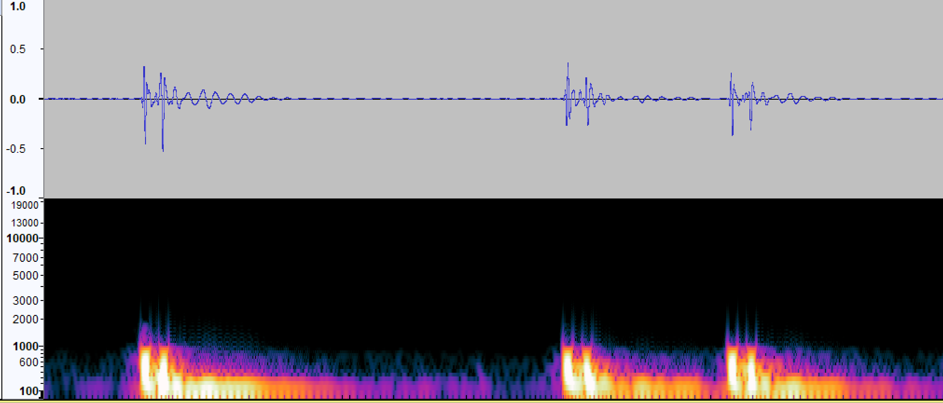
Signal Processing
Audacity
Raw Signal
Processed Signal

Slide 3
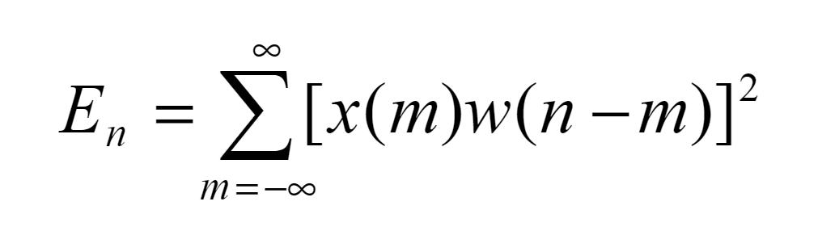
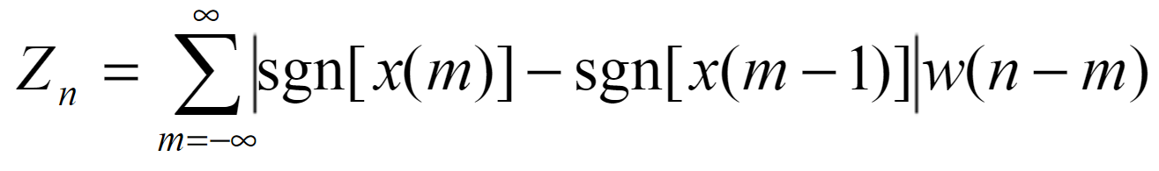
Energy Zero Crossing Calculations
Short-time Energy Calculation
Zero Crossing Rate Calculation

Slide 4
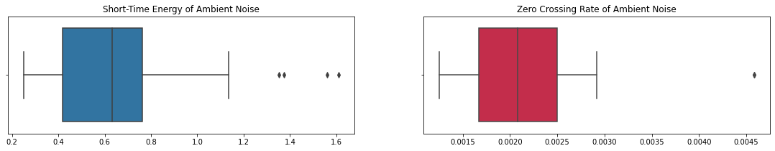
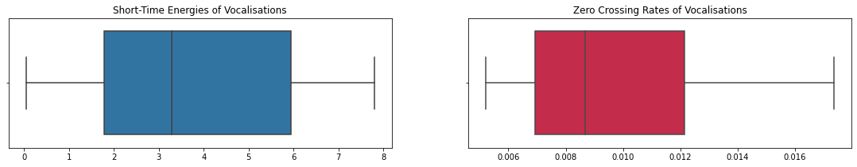
Energy Zero Crossing

Slide 5
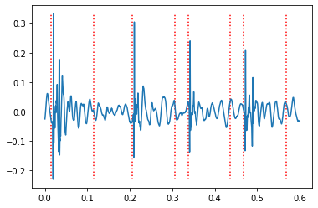
Voice Activation Detection Segmentation

Slide 6
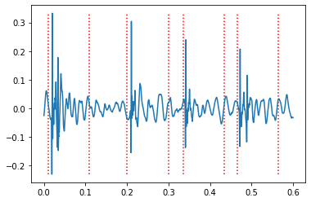
NLEO Segmentation

Slide 7
What’s next

